Slide 1

Cryptography & Network Security
Dakota State University
Distance Education Grant
Dr. Bill Figg

Slide 2
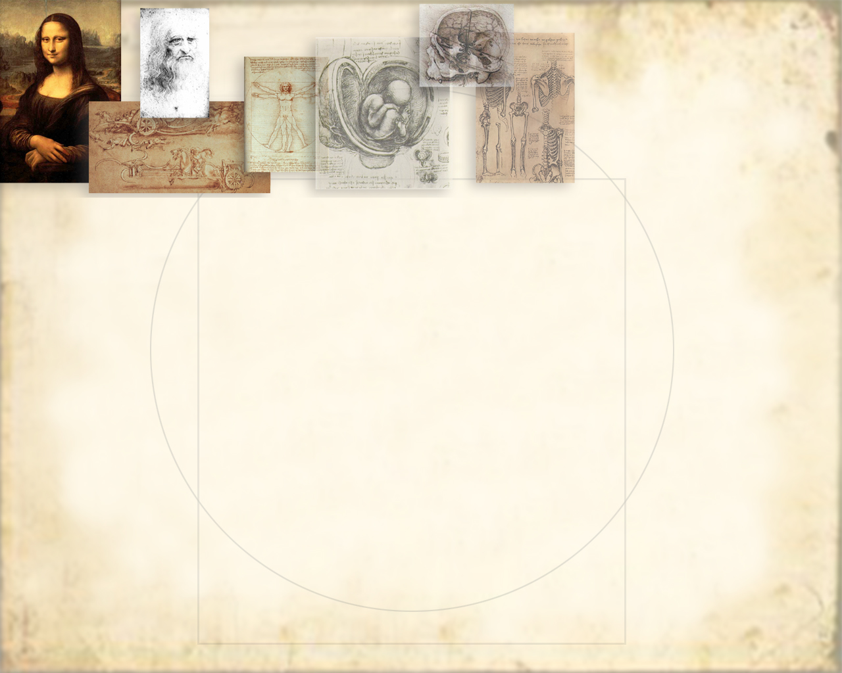
Introduction
The art of war teaches us to rely not on the likelihood of the enemy's not coming, but on our own readiness to receive him; not on the chance of his not attacking, but rather on the fact that we have made our position unassailable.
—The Art of War, Sun Tzu

Slide 3
Security Services
X.800 defines it as: a service provided by a protocol layer of communicating open systems, which ensures adequate security of the systems or of data transfers
RFC 2828 defines it as: a processing or communication service provided by a system to give a specific kind of protection to system resources
X.800 defines it in 5 major categories

Slide 4
Security Services (X.800)
Authentication - assurance that the communicating entity is the one claimed
Access Control - prevention of the unauthorized use of a resource
Data Confidentiality –protection of data from unauthorized disclosure
Data Integrity - assurance that data received is as sent by an authorized entity
Non-Repudiation - protection against denial by one of the parties in a communication

Slide 5
Security Mechanisms (X.800)
specific security mechanisms:
  encipherment, digital signatures, access controls, data integrity, authentication exchange, traffic padding, routing control, notarization
pervasive security mechanisms:
  trusted functionality, security labels, event detection, security audit trails, security recovery

Slide 6
Classify Security Attacks
passive attacks - eavesdropping on, or monitoring of, transmissions to:
  obtain message contents, or
  monitor traffic flows
active attacks – modification of data stream to:
  masquerade of one entity as some other
  replay previous messages
  modify messages in transit
  denial of service

Slide 7
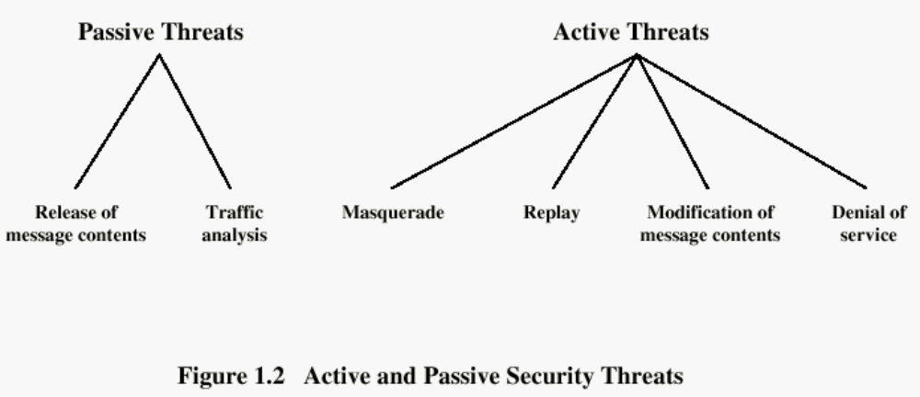
Types of Attacks

Slide 8
Classical Encryption
Techniques
Many savages at the present day regard their names as vital parts of themselves, and therefore take great pains to conceal their real names, lest these should give to evil-disposed persons a handle by which to injure their owners. —The Golden Bough, Sir James George Frazer

Slide 9
Symmetric Encryption
or conventional / private-key / single-key
sender and recipient share a common key
all classical encryption algorithms are private-key
was only type prior to invention of public-key in 1970’s

Slide 10

Symmetric Cipher Model

Slide 11
Cryptography
can be characterized by:
  type of encryption operations used
    substitution / transposition / product
  number of keys used
    single-key or private / two-key or public
  way in which plaintext is processed
    block / stream

Slide 12
Types of Cryptanalytic Attacks
ciphertext only
  only know algorithm / ciphertext, statistical, can identify plaintext
known plaintext
  know/suspect plaintext & ciphertext to attack cipher
chosen plaintext
  select plaintext and obtain ciphertext to attack cipher
chosen ciphertext
  select ciphertext and obtain plaintext to attack cipher
chosen text
  select either plaintext or ciphertext to en/decrypt to attack cipher

Slide 13
Caesar Cipher
earliest known substitution cipher
by Julius Caesar
first attested use in military affairs
replaces each letter by 3rd letter on
example:
  meet me after the toga party
  PHHW PH DIWHU WKH WRJD SDUWB

Slide 14
Cryptanalysis of Caesar Cipher
only have 26 possible ciphers
  A maps to A,B,..Z
could simply try each in turn
a brute force search
given ciphertext, just try all shifts of letters
do need to recognize when have plaintext
eg. break ciphertext "GCUA VQ DTGCM"

Slide 15
Language Redundancy and Cryptanalysis
human languages are redundant
eg "th lrd s m shphrd shll nt wnt"
letters are not equally commonly used
in English e is by far the most common letter
then T,R,N,I,O,A,S
other letters are fairly rare
cf. Z,J,K,Q,X
have tables of single, double & triple letter frequencies

Slide 16
Encrypting and Decrypting
plaintext encrypted two letters at a time:
  if a pair is a repeated letter, insert a filler like 'X', eg. "balloon" encrypts as "ba lx lo on"
  if both letters fall in the same row, replace each with letter to right (wrapping back to start from end), eg. “ar" encrypts as "RM"
  if both letters fall in the same column, replace each with the letter below it (again wrapping to top from bottom), eg. “mu" encrypts to "CM"
  otherwise each letter is replaced by the one in its row in the column of the other letter of the pair, eg. “hs" encrypts to "BP", and “ea" to "IM" or "JM" (as desired)

Slide 17
Polyalphabetic Ciphers
another approach to improving security is to use multiple cipher alphabets
called polyalphabetic substitution ciphers
makes cryptanalysis harder with more alphabets to guess and flatter frequency distribution
use a key to select which alphabet is used for each letter of the message
use each alphabet in turn
repeat from start after end of key is reached

Slide 18
One-Time Pad
if a truly random key as long as the message is used, the cipher will be secure
called a One-Time pad
is unbreakable since ciphertext bears no statistical relationship to the plaintext
since for any plaintext & any ciphertext there exists a key mapping one to other
can only use the key once though
have problem of safe distribution of key

Slide 19
Transposition Ciphers
now consider classical transposition or permutation ciphers
these hide the message by rearranging the letter order
without altering the actual letters used
can recognise these since have the same frequency distribution as the original text

Slide 20
Row Transposition Ciphers
a more complex scheme
write letters of message out in rows over a specified number of columns
then reorder the columns according to some key before reading off the rows
  Key: 3 4 2 1 5 6 7
  Plaintext: a t t a c k p
  o s t p o n e
  d u n t i l t
  w o a m x y z
  Ciphertext: TTNAAPTMTSUOAODWCOIXKNLYPETZ

Slide 21
Steganography
an alternative to encryption
hides existence of message
  using only a subset of letters/words in a longer message marked in some way
  using invisible ink
  hiding in LSB in graphic image or sound file
has drawbacks
  high overhead to hide relatively few info bits

Slide 22
Block vs Stream Ciphers
block ciphers process messages in into blocks, each of which is then en/decrypted
like a substitution on very big characters
  64-bits or more
stream ciphers process messages a bit or byte at a time when en/decrypting
many current ciphers are block ciphers
hence are focus of course

Slide 23
Confusion and Diffusion
cipher needs to completely obscure statistical properties of original message
a one-time pad does this
more practically Shannon suggested combining elements to obtain:
diffusion – dissipates statistical structure of plaintext over bulk of ciphertext
confusion – makes relationship between ciphertext and key as complex as possible

Slide 24
Feistel Cipher Structure
Horst Feistel devised the feistel cipher
  based on concept of invertible product cipher
partitions input block into two halves
  process through multiple rounds which
  perform a substitution on left data half
  based on round function of right half & subkey
  then have permutation swapping halves
implements Shannon’s substitution-permutation network concept

Slide 25
Differential Cryptanalysis
one of the most significant recent (public) advances in cryptanalysis
known by NSA in 70's cf DES design
Murphy, Biham & Shamir published 1990
powerful method to analyse block ciphers
used to analyse most current block ciphers with varying degrees of success
DES reasonably resistant to it, cf Lucifer

Slide 26
Linear Cryptanalysis
another recent development
also a statistical method
must be iterated over rounds, with decreasing probabilities
developed by Matsui et al in early 90's
based on finding linear approximations
can attack DES with 2⁴⁷ known plaintexts, still in practise infeasible

Slide 27
Electronic Codebook Book (ECB)
message is broken into independent blocks which are encrypted
each block is a value which is substituted, like a codebook, hence name
each block is encoded independently of the other blocks
  C_{i} = DES_{K1} (P_{i})
uses: secure transmission of single values

Slide 28
AES Evaluation Criteria
initial criteria:
  security – effort to practically cryptanalyse
  cost – computational
  algorithm & implementation characteristics
final criteria
  general security
  software & hardware implementation ease
  implementation attacks
  flexibility (in en/decrypt, keying, other factors)

Slide 29
The AES Cipher - Rijndael
designed by Rijmen-Daemen in Belgium
has 128/192/256 bit keys, 128 bit data
an iterative rather than feistel cipher
  treats data in 4 groups of 4 bytes
  operates an entire block in every round
designed to be:
  resistant against known attacks
  speed and code compactness on many CPUs
  design simplicity

Slide 30
AES Decryption
AES decryption is not identical to encryption since steps done in reverse
but can define an equivalent inverse cipher with steps as for encryption
  but using inverses of each step
  with a different key schedule
works since result is unchanged when
  swap byte substitution & shift rows
  swap mix columns & add (tweaked) round key

Slide 31
Triple-DES with Two-Keys
hence must use 3 encryptions
  would seem to need 3 distinct keys
but can use 2 keys with E-D-E sequence
  C = E_{K1}[D_{K2}[E_{K1}[P]]]
  nb encrypt & decrypt equivalent in security
  if K1=K2 then can work with single DES
standardized in ANSI X9.17 & ISO8732
no current known practical attacks

Slide 32
Triple-DES with Three-Keys
although are no practical attacks on two-key Triple-DES have some indications
can use Triple-DES with Three-Keys to avoid even these
  C = E_{K3}[D_{K2}[E_{K1}[P]]]
has been adopted by some Internet applications, eg PGP, S/MIME

Slide 33
Confidentiality using Symmetric Encryption
have two major placement alternatives
link encryption
  encryption occurs independently on every link
  implies must decrypt traffic between links
  requires many devices, but paired keys
end-to-end encryption
  encryption occurs between original source and final destination
  need devices at each end with shared keys

Slide 34
Placement of Encryption
can place encryption function at various layers in OSI Reference Model
  link encryption occurs at layers 1 or 2
  end-to-end can occur at layers 3, 4, 6, 7
  as move higher less information is encrypted but it is more secure though more complex with more entities and keys

Slide 35
Key Distribution
symmetric schemes require both parties to share a common secret key
issue is how to securely distribute this key
often secure system failure due to a break in the key distribution scheme

Slide 36
Key Distribution
given parties A and B have various key distribution alternatives:
  A can select key and physically deliver to B
  third party can select & deliver key to A & B
  if A & B have communicated previously can use previous key to encrypt a new key
  if A & B have secure communications with a third party C, C can relay key between A & B

Slide 37
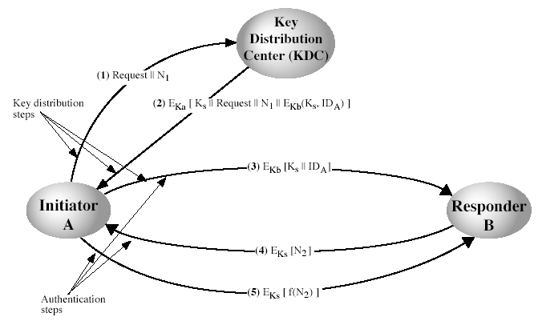
Key Distribution Scenario

Slide 38
Key Distribution Issues
hierarchies of KDC’s required for large networks, but must trust each other
session key lifetimes should be limited for greater security
use of automatic key distribution on behalf of users, but must trust system
use of decentralized key distribution
controlling purposes keys are used for

Slide 39
Random Numbers
many uses of random numbers in cryptography
  nonces in authentication protocols to prevent replay
  session keys
  public key generation
  keystream for a one-time pad
in all cases its critical that these values be
  statistically random
    with uniform distribution, independent
  unpredictable cannot infer future sequence on previous values

Slide 40
Private-Key Cryptography
traditional private/secret/single key cryptography uses one key
shared by both sender and receiver
if this key is disclosed communications are compromised
also is symmetric, parties are equal
hence does not protect sender from receiver forging a message & claiming is sent by sender

Slide 41
Public-Key Cryptography
probably most significant advance in the 3000 year history of cryptography
uses two keys – a public & a private key
asymmetric since parties are not equal
uses clever application of number theoretic concepts to function
complements rather than replaces private key crypto

Slide 42
Public-Key Cryptography
public-key/two-key/asymmetric cryptography involves the use of two keys:
  a public-key, which may be known by anybody, and can be used to encrypt messages, and verify signatures
  a private-key, known only to the recipient, used to decrypt messages, and sign (create) signatures
is asymmetric because
  those who encrypt messages or verify signatures cannot decrypt messages or create signatures

Slide 43

Public-Key Cryptography

Slide 44
Public-Key Characteristics
Public-Key algorithms rely on two keys with the characteristics that it is:
  computationally infeasible to find decryption key knowing only algorithm & encryption key
  computationally easy to en/decrypt messages when the relevant (en/decrypt) key is known
  either of the two related keys can be used for encryption, with the other used for decryption (in some schemes)

Slide 45
Key Management
public-key encryption helps address key distribution problems
have two aspects of this:
  distribution of public keys
  use of public-key encryption to distribute secret keys

Slide 46
Public-Key Certificates
certificates allow key exchange without real-time access to public-key authority
a certificate binds identity to public key
  usually with other info such as period of validity, rights of use etc
with all contents signed by a trusted Public-Key or Certificate Authority (CA)
can be verified by anyone who knows the public-key authorities public-key

Slide 47
Message Authentication Code (MAC)
generated by an algorithm that creates a small fixed-sized block
  depending on both message and some key
  like encryption though need not be reversible
appended to message as a signature
receiver performs same computation on message and checks it matches the MAC
provides assurance that message is unaltered and comes from sender

Slide 48
Hash Functions
condenses arbitrary message to fixed size
usually assume that the hash function is public and not keyed
  cf. MAC which is keyed
hash used to detect changes to message
can use in various ways with message
most often to create a digital signature

Slide 49
Keyed Hash Functions as MACs
have desire to create a MAC using a hash function rather than a block cipher
  because hash functions are generally faster
  not limited by export controls unlike block ciphers
hash includes a key along with the message
original proposal:
  KeyedHash = Hash(Key|Message)
  some weaknesses were found with this
eventually led to development of HMAC

Slide 50
Digital Signature Properties
must depend on the message signed
must use information unique to sender
  to prevent both forgery and denial
must be relatively easy to produce
must be relatively easy to recognize & verify
be computationally infeasible to forge
  with new message for existing digital signature
  with fraudulent digital signature for given message
be practical save digital signature in storage

Slide 51
Arbitrated Digital Signatures
involves use of arbiter A
  validates any signed message
  then dated and sent to recipient
requires suitable level of trust in arbiter
can be implemented with either private or public-key algorithms
arbiter may or may not see message

Slide 52
Authentication Protocols
used to convince parties of each others identity and to exchange session keys
may be one-way or mutual
key issues are
  confidentiality – to protect session keys
  timeliness – to prevent replay attacks

Slide 53
Digital Signature Standard (DSS)
US Govt approved signature scheme FIPS 186
uses the SHA hash algorithm
designed by NIST & NSA in early 90's
DSS is the standard, DSA is the algorithm
a variant on ElGamal and Schnorr schemes
creates a 320 bit signature, but with 512-1024 bit security
security depends on difficulty of computing discrete logarithms

Slide 54
DSA Signature Creation
to sign a message M the sender:
  generates a random signature key k, k<q
  nb. k must be random, be destroyed after use, and never be reused
then computes signature pair:
  r = (g^{k}(mod p))(mod q)
  s = (k⁻¹.SHA(M)+ x.r)(mod q)
sends signature (r,s) with message M

Slide 55
Web Security
Web now widely used by business, government, individuals
but Internet & Web are vulnerable
have a variety of threats
  integrity
  confidentiality
  denial of service
  authentication
need added security mechanisms

Slide 56
SSL (Secure Socket Layer)
transport layer security service
originally developed by Netscape
version 3 designed with public input
subsequently became Internet standard known as TLS (Transport Layer Security)
uses TCP to provide a reliable end-to-end service
SSL has two layers of protocols

Slide 57
SSL Handshake Protocol
allows server & client to:
  authenticate each other
  to negotiate encryption & MAC algorithms
  to negotiate cryptographic keys to be used
comprises a series of messages in phases
  Establish Security Capabilities
  Server Authentication and Key Exchange
  Client Authentication and Key Exchange
  Finish

Slide 58
What is a Firewall?
a choke point of control and monitoring
interconnects networks with differing trust
imposes restrictions on network services
  only authorized traffic is allowed
auditing and controlling access
  can implement alarms for abnormal behavior
is itself immune to penetration
provides perimeter defence

Slide 59
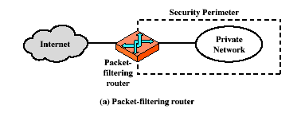
Firewalls – Packet Filters

Slide 60
Firewalls – Packet Filters
simplest of components
foundation of any firewall system
examine each IP packet (no context) and permit or deny according to rules
hence restrict access to services (ports)
possible default policies
  that not expressly permitted is prohibited
  that not expressly prohibited is permitted

Slide 61
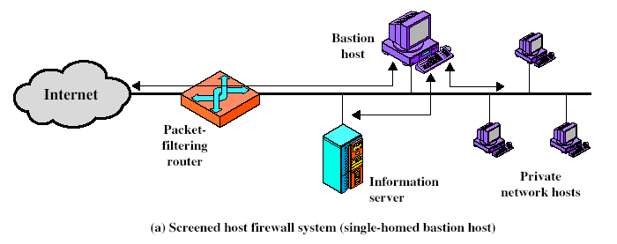
Firewall Configurations

Slide 62
Trusted Computer Systems
have considered some application specific security mechanisms
  eg. S/MIME, PGP, Kerberos, SSL/HTTPS
however there are security concerns that cut across protocol layers
would like security implemented by the network for all applications

Slide 63
Summary
information security is increasingly important
have varying degrees of sensitivity of information
  cf military info classifications: confidential, secret etc
subjects (people or programs) have varying rights of access to objects (information)
want to consider ways of increasing confidence in systems to enforce these rights
known as multilevel security
  subjects have maximum & current security level
  objects have a fixed security level classification

